Slide 1
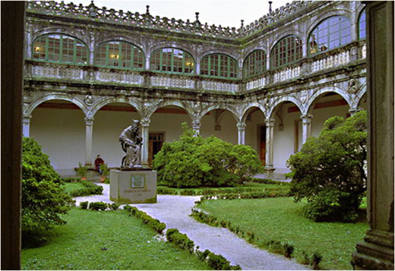
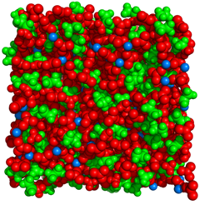
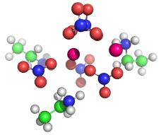
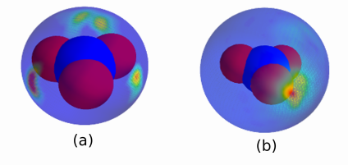
LITHIUM SOLVATION IN PROTIC IONIC LIQUIDS
COST EXIL Meeting
Dresden, November 25th 2013
Luis M. Varela,ª Trinidad Méndez-Moralesª, Jesús Carrete,^{a,b}, Óscar Cabeza,^{c} Olga Russina,^{d} Alessandro Triolo,^{e} Luis J. Gallegoª
ªGrupo de Nanomateriais e Materia Branda, Departamento de Física da Materia Condensada, Universidade de Santiago de Compostela, Campus Vida s/n E-15782, Santiago de Compostela, Spain
^{b} LITEN, CEA-Grenoble, 17 rue des Martyrs, BP166, F-38054, Grenoble, Cedex 9, France
^{c}Mesturas Group Facultade de Ciencias, Universidade da Coruña, Campus A Zapateira s/n E-15008, A Coruña, Spain
^{d} Dipartimento di Chimica, Università della Sapienza. P. le Aldo Moro 5 Roma, IT 00185, Italy
^{e}Istituto Struttura della Materia, Consiglio Nazionale delle Ricerche, Area della Ricerca di Tor Vergata, Via del Fosso del Cavaliere 100, I-00133 Rome, Italy

Slide 2
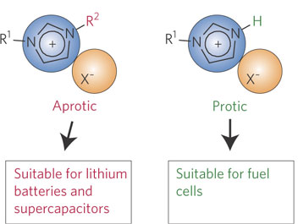
ELECTROCHEMICAL APPLICATIONS:
ILs currently considered as the most promising electrolytes for electrochemical devices.
Each class of IL traditionally considered suitable for an specific application.

Slide 3
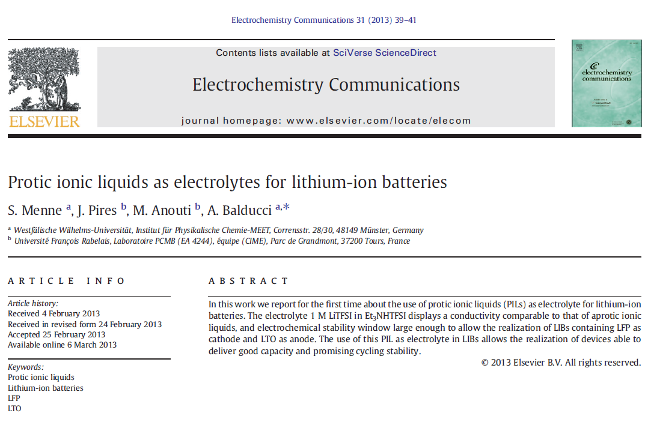
ELECTROCHEMICAL APPLICATIONS:
NOTWITHSTANDING…
PILs:
-Cheaper
-Easier synthesis

Slide 4
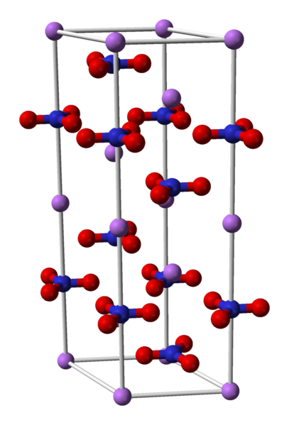
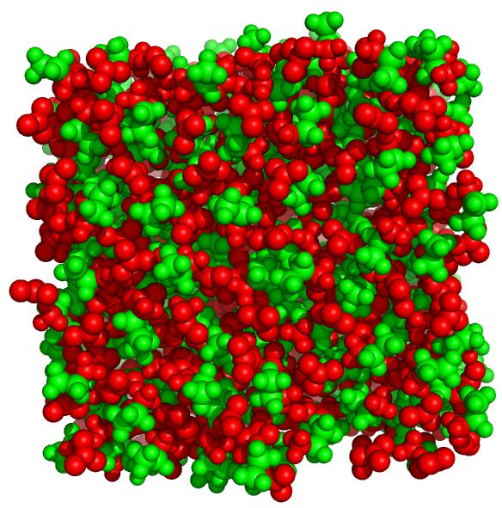
ELECTROCHEMICAL APPLICATIONS:
SOLUTIONS OF ELECTROCHEMICALLY RELEVANT SALTS IN PILS MUST BE CONSIDERED
http://upload.wikimedia.org/wikipedia/commons/6/61/Lithium-nitrate-unit-cell-3D-balls.png

Slide 5
ELECTROCHEMICAL APPLICATIONS:
SOLUTIONS OF ELECTROCHEMICALLY RELEVANT SALTS IN PILS MUST BE CONSIDERED
http://upload.wikimedia.org/wikipedia/commons/6/61/Lithium-nitrate-unit-cell-3D-balls.png

Slide 6
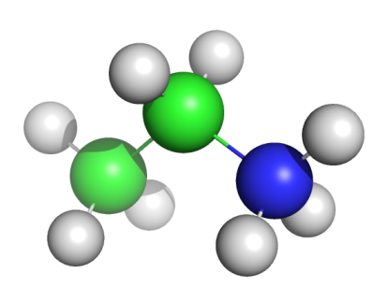
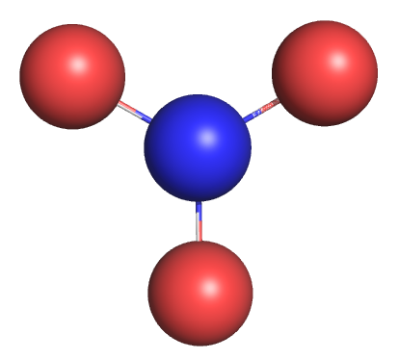
MD SIMULATIONS:
- MD simulations of a PIL (EAN) mixed with a lithium salt with a common anion (LiNO3 – 0%, 5%, 10%, 15%, 20% and 25%) at 298.15 K.
Providing a detailed picture of the structural properties of lithium salt-doped ILs.
Determining the Li⁺ cation environment at the molecular level (ion solvation in PILs).
This affects transport properties of the electrolyte and play a fundamental role in the performance of electrochemical devices.
Molecular structures of ethylammonium and nitrate ions.

Slide 7
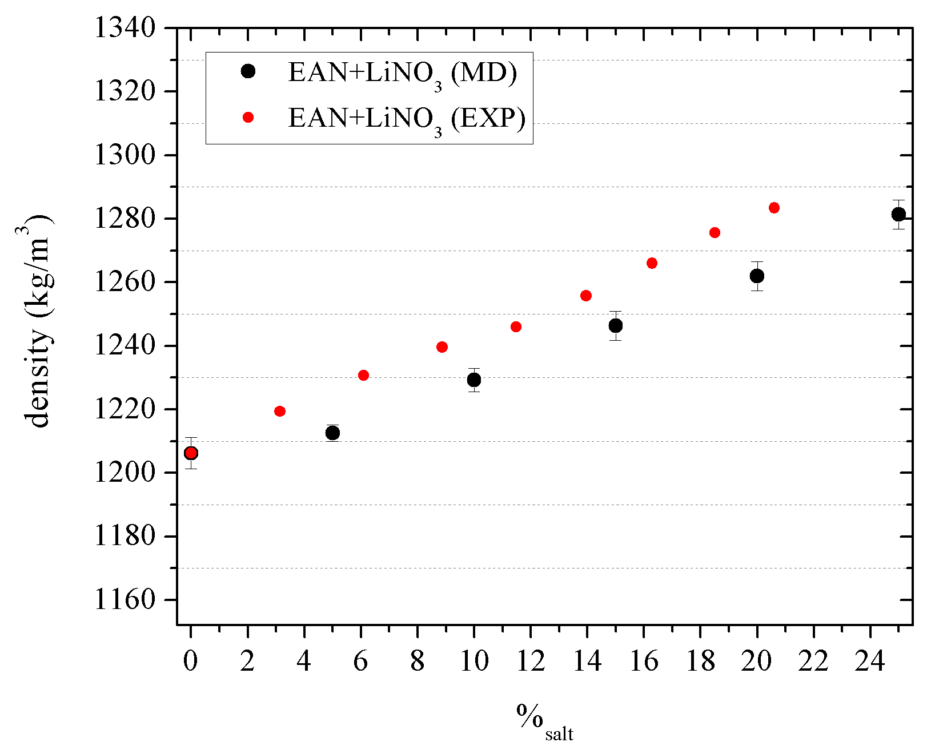
RESULTS: density.
MD simulations were performed by using GROMACS → force field: OPLS-AA all-atom; non-polarizable (interest mainly on structure).
The predicted density shows less than a 1.5% of deviation.
T. Méndez-Morales et al. JPCB, accepted for publication

Slide 8
RESULTS: radial distribution functions (RDFs).
- Strong network of hydrogen bonds in EAN.
Formation of polar (nitrate ion and ammonium group) and apolar domains (methylene and methyl groups) in the bulk.
- Electrostatic interactions in EAN.
How does Li⁺ accommodate in the two networks?
Why LiNO₃ precipitates?
Polar and apolar domains in pure EAN.

Slide 9
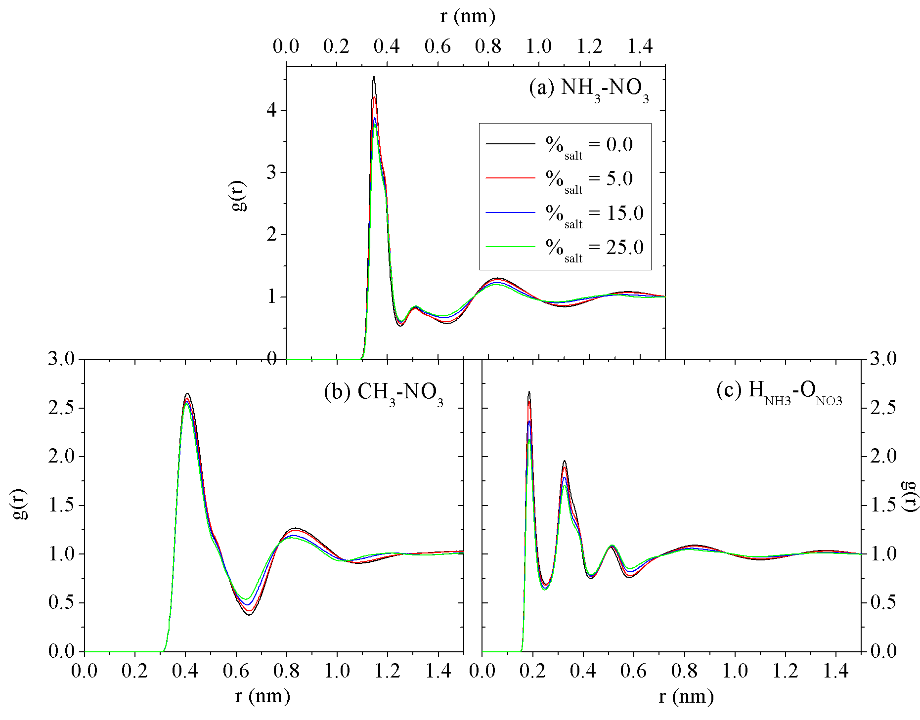
RESULTS: radial distribution functions (RDFs).
Structure of EAN: only slightly affected by LiNO₃ addition
T. Méndez-Morales et al. JPCB, accepted for publication

Slide 10
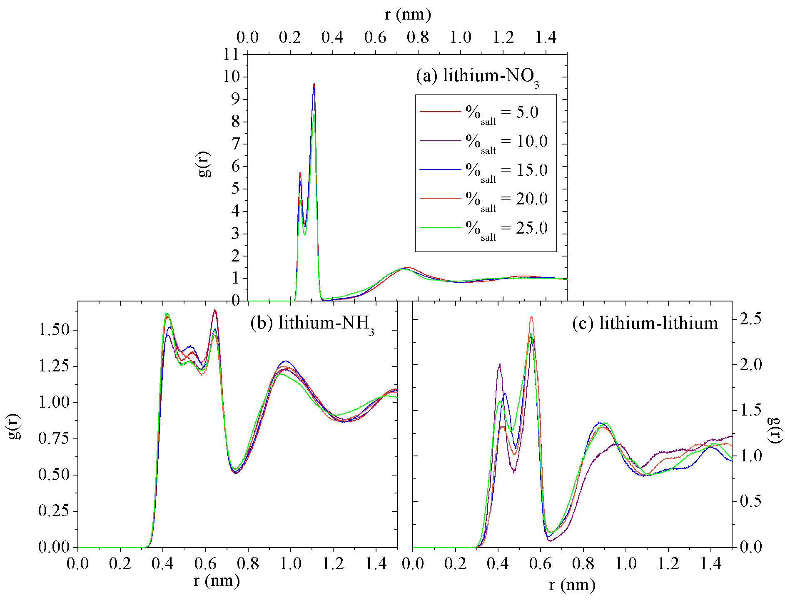
RESULTS: radial distribution functions (RDFs).
T. Méndez-Morales et al. JPCB, accepted for publication

Slide 11
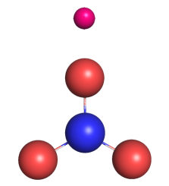
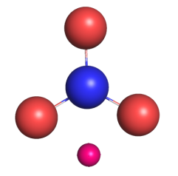
RESULTS: radial distribution functions (RDFs).
Two peaks in the first solvation shell: lithium ion has two different conformations (monodentate and bidentate) around the nitrate anion.
More abundant.
T. Méndez-Morales et al. JPCB, accepted for publication

Slide 12
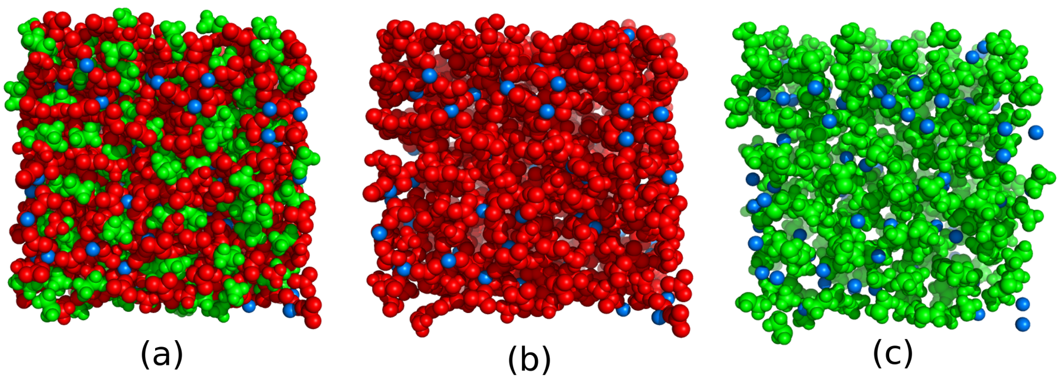
RESULTS: snapshots.
BUT… where is lithium?
whole system
polar domains + lithium
apolar domains + lithium
T. Méndez-Morales et al. JPCB, accepted for publication

Slide 13
RESULTS: radial distribution functions (RDFs).
Polar regions: molten or solid-like LiNO3?
T. Méndez-Morales et al. JPCB, accepted for publication

Slide 14
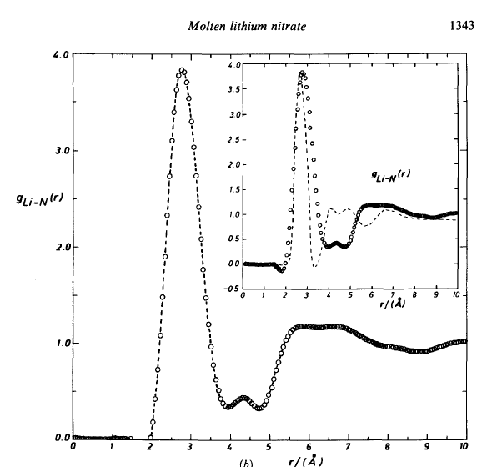
RESULTS: radial distribution functions (RDFs).
Molten lithium-nitrate does not exhibit the double peak in the lithium-anion RDF.

Slide 15
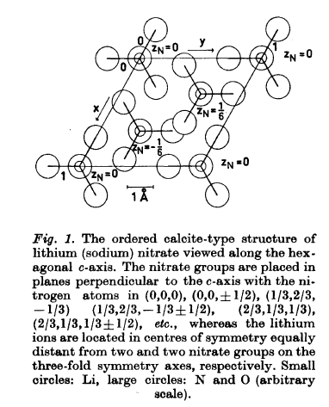
RESULTS: radial distribution functions (RDFs).
These distributions somehow reminds that of the calcite type structure characteristic of a crystal of lithium nitrate.
Molten lithium-nitrate does not exhibit the double peak in the lithium-anion RDF.

Slide 16
RESULTS: snapshots.
whole system
polar domains + lithium
apolar domains + lithium
Lithium cations are mainly located in the polar regions of the solutions in a solid-like fashion
Great influence in the network of hydrogen bonds formed PILs.

Slide 17
RESULTS: snapshots.
Nitrate anion interacts more significantly with the ammonium group than with the methyl group of the ethylammonium cation.
A given Li⁺ is surrounded by:

Slide 18
RESULTS: snapshots.
Nitrate anion interacts more significantly with the ammonium group than with the methyl group of the ethylammonium cation.
A given Li⁺ is surrounded by:
A first solvation layer of nitrate anions in two possible conformations.

Slide 19
RESULTS: snapshots.
Nitrate anion interacts more significantly with the ammonium group than with the methyl group of the ethylammonium cation.
A given Li⁺ is surrounded by:
A first solvation layer of nitrate anions in two possible conformations.
A second layer of both lithium and ethylammonium cations.

Slide 20
RESULTS: snapshots.
Nitrate anion interacts more significantly with the ammonium group than with the methyl group of the ethylammonium cation.
A given Li⁺ is surrounded by:
- Lithiums are placed in the polar nanodomains in a solid-like pseudolattice structure, avoiding contacts with the hydrophobic domains of the IL.
A first solvation layer of nitrate anions in two possible conformations.
A second layer of both lithium and ethylammonium cations.
Electrostatic interactions.
Hydrogen bonds.

Slide 21
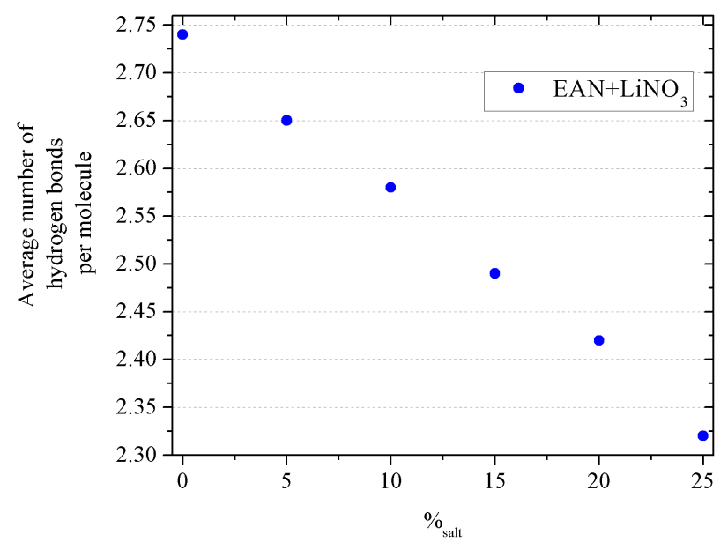
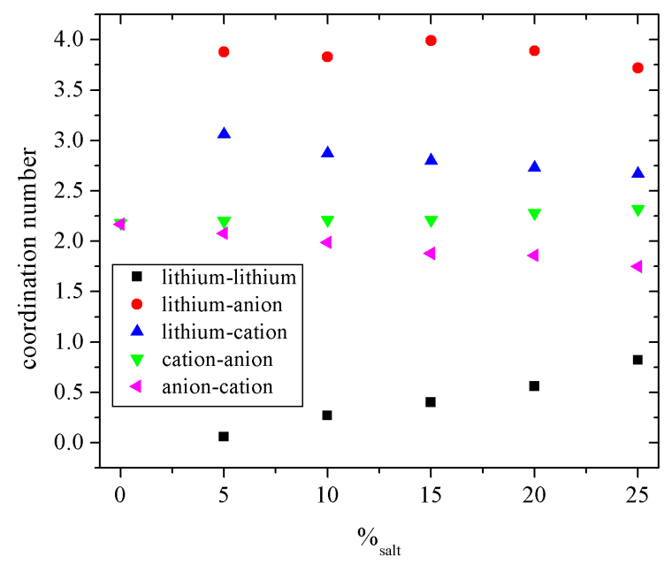
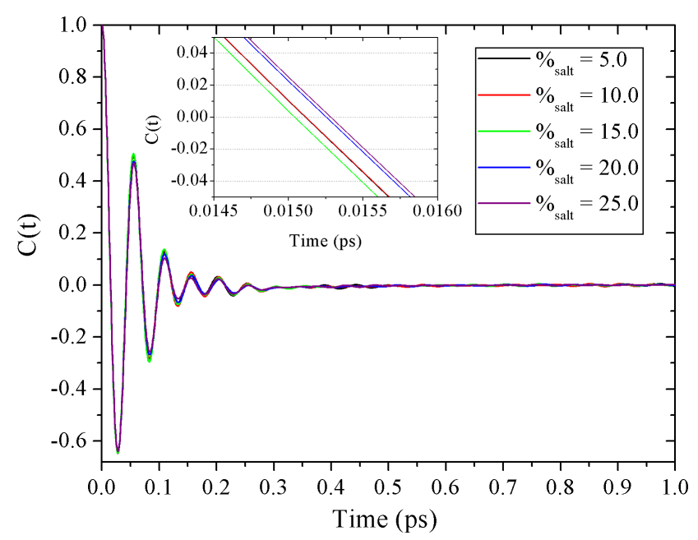
RESULTS: hydrogen bonds/Coord. Numbers/VACF

Slide 22
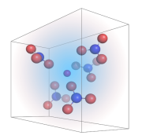
RESULTS: hydrogen bonds/Coord. Numbers/VACF
Collision time: 0.3 ps
T. Méndez-Morales et al. JPCB, accepted for publication
Rattling motion of lithium ions
in their “cages”

Slide 23
CONCLUSIONS:
Lithium cations: dispersed in polar environments of PIL-salt solutions Gradual disruption of the PIL network of hydrogen bonds.
- Solid-like, short-ranged order in the polar regions reminiscent of pseudolattice structures in which lithium cations are surrounded by an average of four anions in two different conformations, monodentate and bidentate.
T. Méndez-Morales et al. JPCB, accepted for publication
We propose that this is a new solvation mechanism: nanostructured solvation. Solvation of solid-like clusters in the polar nanorregions of an IL acting like crystallization-nuclei

Slide 24
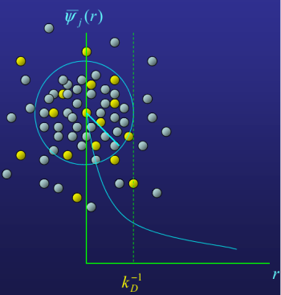
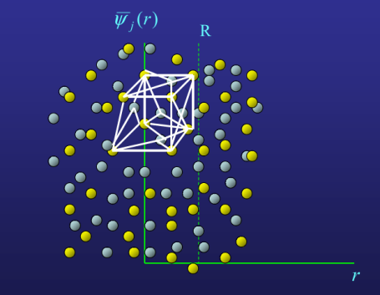
WORK IN PROGRESS: Pseudolattice theory
Li⁺ solvation in longer chained members of the ethylammonium nitrate family
Extensions of pseudolattice theory

Slide 25
ACKNOWLEDGMENTS:
Xunta de Galicia (Spain) for ﬁnancial support through the research projects of references 10-PXI-103-294 PR, 10-PXIB-206-294 PR and GPC2013-043, partially supported by FEDER.
Spanish Ministry of Science and Innovation (Grant No. FIS2012-33126).
FIRB-Futuro in Ricerca (RBFR086BOQ) and PRIN (2009WHPHRH)
T. M.-M. thanks the Spanish ministry of Education for her FPU grant.
Facilities provided by the Galician Supercomputing Centre (CESGA)

Slide 26
Thank you very
much for your
attention…

Slide 27
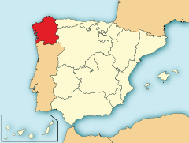
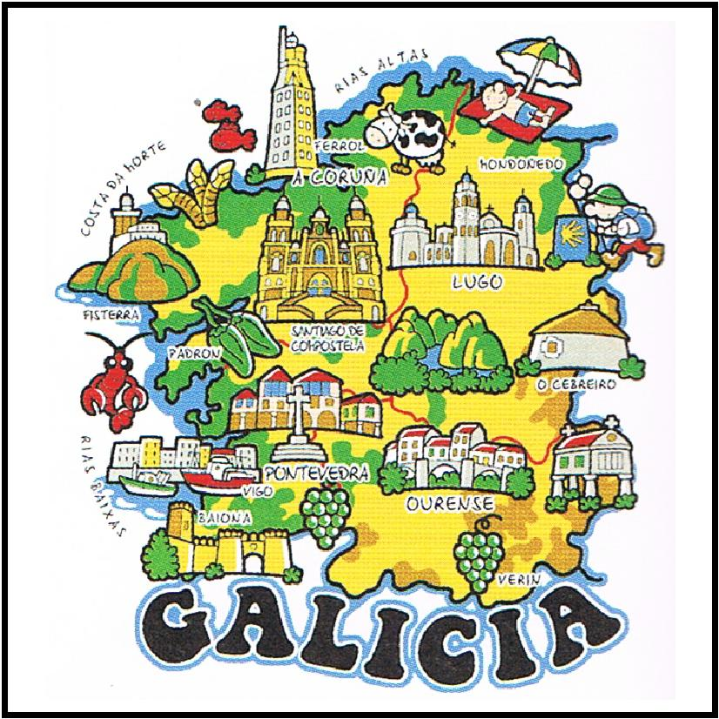
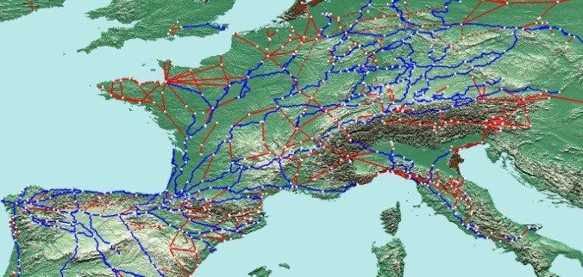
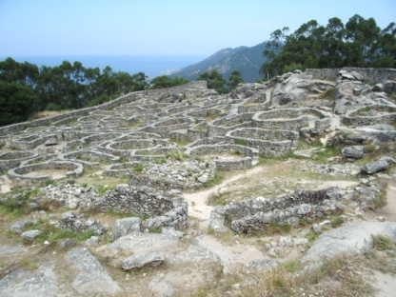
…and visit Galicia.

Slide 28
LITHIUM SOLVATION IN PROTIC IONIC LIQUIDS
COST EXIL Meeting
Dresden, November 25th 2013
Luis M. Varela,ª Trinidad Méndez-Moralesª, Jesús Carrete,^{a,b}, Óscar Cabeza,^{c} Olga Russina,^{d} Alessandro Triolo,^{e} Luis J. Gallegoª
ªGrupo de Nanomateriais e Materia Branda, Departamento de Física da Materia Condensada, Universidade de Santiago de Compostela, Campus Vida s/n E-15782, Santiago de Compostela, Spain
^{b} LITEN, CEA-Grenoble, 17 rue des Martyrs, BP166, F-38054, Grenoble, Cedex 9, France
^{c}Mesturas Group Facultade de Ciencias, Universidade da Coruña, Campus A Zapateira s/n E-15008, A Coruña, Spain
^{d} Dipartimento di Chimica, Università della Sapineza. P. le Aldo Moro 5 Roma, IT 00185, Italy
^{e}Istituto Struttura della Materia, Consiglio Nazionale delle Ricerche, Area della Ricerca di Tor Vergata, Via del Fosso del Cavaliere 100, I-00133 Rome, Italy

