Slide 1


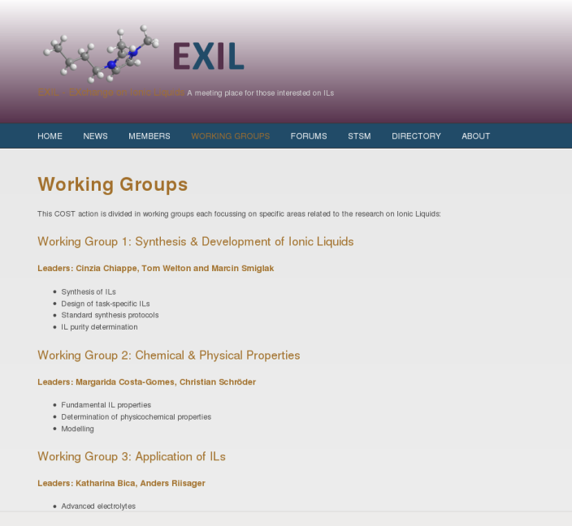
CM 1206
Exchange on Ionic liquids
Working Group 2 Chemical and Physical Properties of Ionic Liquids
http://www.usc.es/exil

Slide 2
CM 1206
Exchange on Ionic liquids
Working Group 2 Chemical and Physical Properties of Ionic Liquids
Fundamental understanding of IL interactions
  between cations and anions
  between IL ions and solutes
  at surfaces
Determination of physicochemical properties
  Pure ILs
  Mixtures with co-solvents
Modelling
  Computer-aided design
  Analysis of structural ordering (at surfaces)
  Computation and prediction of physico-chemical properties

Slide 3
CM 1206
Exchange on Ionic liquids
Working Group 2 Chemical and Physical Properties of Ionic Liquids
Margarida Costa Gomes
Institut de chimie de Clermont-Ferrand
Universite Blaise Pascal / CNRS
Clermont-Ferrand
Phone: +33 47340 7205
Fax: +33 47340 7185
Email: margarida.c.gomes@univ-bpclermont.fr
Christian Schröder
Institute of Computational Biological Chemistry
University of Vienna
Phone: +43 14277 52711
Fax: +43 14277 852711
Email: christian.schroeder@univie.ac.at

Slide 4
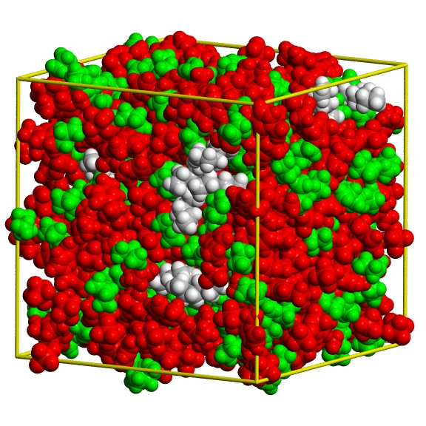
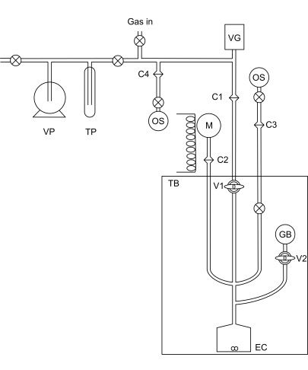
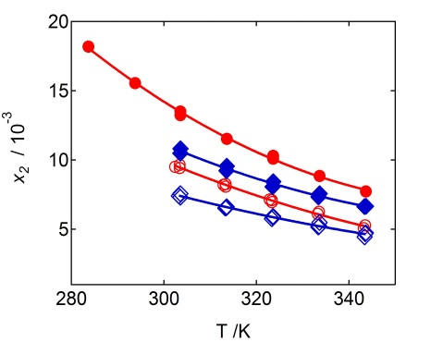



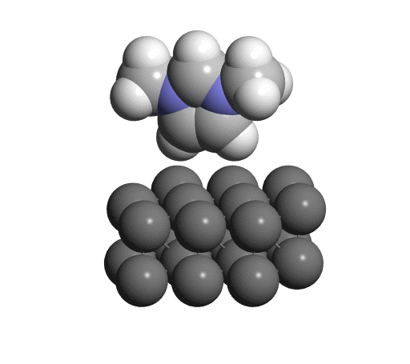
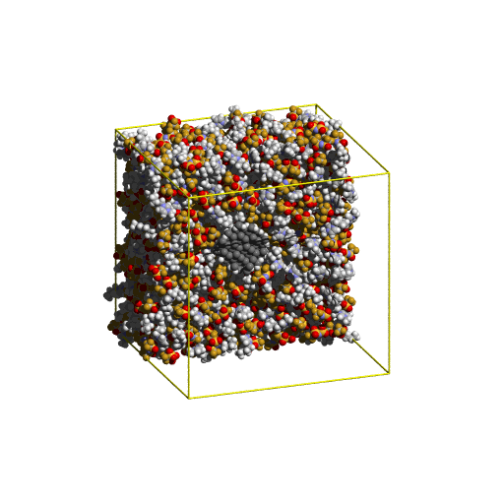
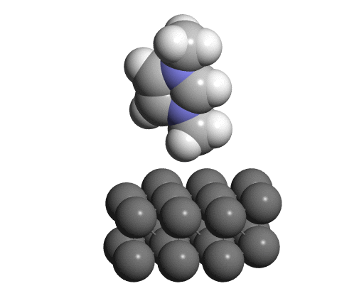
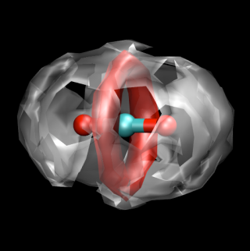
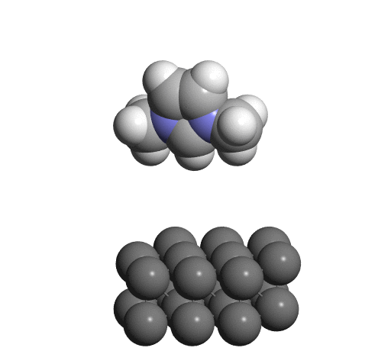
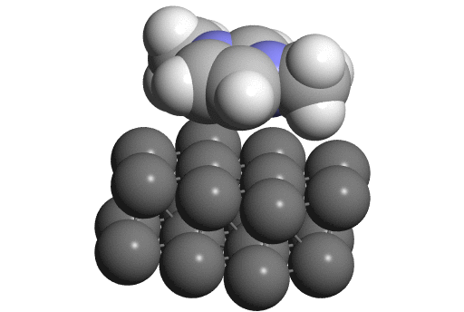
CM 1206
Exchange on Ionic liquids
Margarida Costa Gomes
Experimental thermodynamics
Solvation in ionic liquids
  Gas-liquid and liquid-liquid equilibria
  Energetics of solvation
  Solvation-structure relationships
  Interactions ionic liquid- material
Transport properties
  Viscosity
  Ionic conductivity and diffusion coefficients
Ionic liquids in the environment
  Partition coefficients
  Transport in the aqueous compartiment

Slide 5
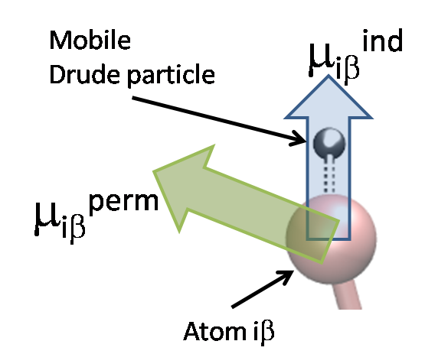
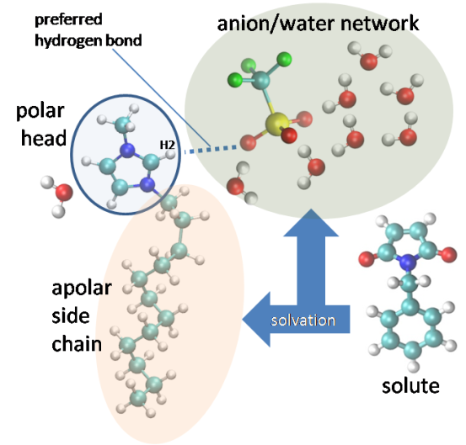
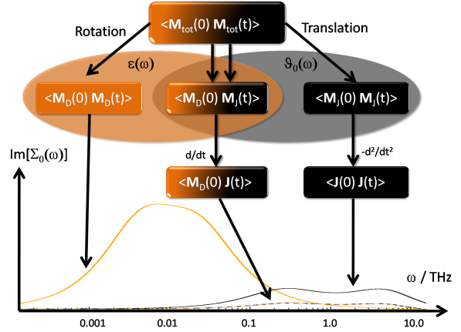
CM 1206
Exchange on Ionic liquids
Christian Schröder
Polarizable MD simulations
  Drude oscillators
  Point-induced dipoles
Biomolecular solvation in IL / H₂O mixtures
  Protein solvation
  Small biomolecules
  Without solute
Computational spectroscopy
  Dielectric spectra
  Solvation dynamics spectroscopy
  (OKE spectroscopy)

Slide 6
CM 1206
Exchange on Ionic liquids
Activities of Working Group 2
Contact with the members of the Management Committee
Contact between European PIs and the WG2 leaders
Extension of the network
Communication through a newsletter
    Approximately every three month (date will be fixed on the web page)
    News from the management committee
    Upcoming workshops / working group meetings
    Call for actions:
      Topics for the next working group meeting
      STSM in the frame
      Evaluation of physico-chemical properties

Slide 7
CM 1206
Exchange on Ionic liquids
First Round 2013 – Short Term Scientific Missions
Probing dynamics of ILs by solvation and photon correlation spectroscopy
Extraction of pharmaceuticals using aqueous biphasic systems
Chemi- and physisorption of CO₂ in ILs
Viscosimetric characterization of ILs at high pressures
Heterogeneous dynamics of ILs studied with polarizable MD simulations
Interactions and structure in IL solutions

Slide 8
CM 1206
Exchange on Ionic liquids
CECAM workshop
Working Group 2 meeting
Spring 2014 in Lausanne, Switzerland
Multiscale modeling of ILs: From quantum methods to coarse-grained models
Organizers: Agilio Padua, France
Jose Canongia Lopes, Portugal
Invited Speakers: 17 invited speakers from Europe, USA, India, Brazil and Australia.

Slide 9
CM 1206
Exchange on Ionic liquids
Workshops,
Group projects (EU funded?),
Publications ...
Other ideas?
Structure of ionic liquid solutions by NMR and simulation
Measurement and modelling of transport properties
Contribution to databases on properties of ionic liquids
Interactions between ionic liquids and materials (polymers, materials,...)
Connection to other WG – joint meetings?

Slide 10
CM 1206
Exchange on Ionic liquids
Working Group 2 Chemical and Physical Properties of Ionic Liquids
15:30 – 15:45 Introduction
15:45 – 15:55 Monitoring interactions in Ils using vibrational spectroscopy Dracopoulos
15:55 – 16:05 On the role of X-ray and neutron scattering to Triolo
describe structure and dynamics in ILs
16:05 – 16:15 Dynamic light scattering Blochowicz
16:15 – 16:25 Lithium solvation in protic ionic liquids Varela
16:25 – 16:35 Electrochemical reactivity in ionic liquids Lagrost
16:35 – 16:45 Extraction properties from experimental studies on limiting Domanska
activity coefficients of various solutes in ILs
16:45 – 16:55 LTPEP: Equipment and measuring ranges Mylona

